Slide 1
Credit Risk Modeling

Slide 2

Executive Summary
Problem Current credit approval strategy results in an overall default rate of 24.65% leading to increased company costs and reduced profits.
Solution Utilize the outcomes of a credit risk assessment model, which forecasts the likelihood of default (PD), to inform the determination of whether to approve a credit application.
Strategy Approve applicants with a conservative PD < 40% or an aggressive PD < 60%.
Goals Implemented strategy reduces the overall default rate within 5% to 10% leading to decreased costs and increased profits.
Notes:
The conservative strategy has a lower threshold compared with the aggressive one; hence accepts less applicants.

Slide 3
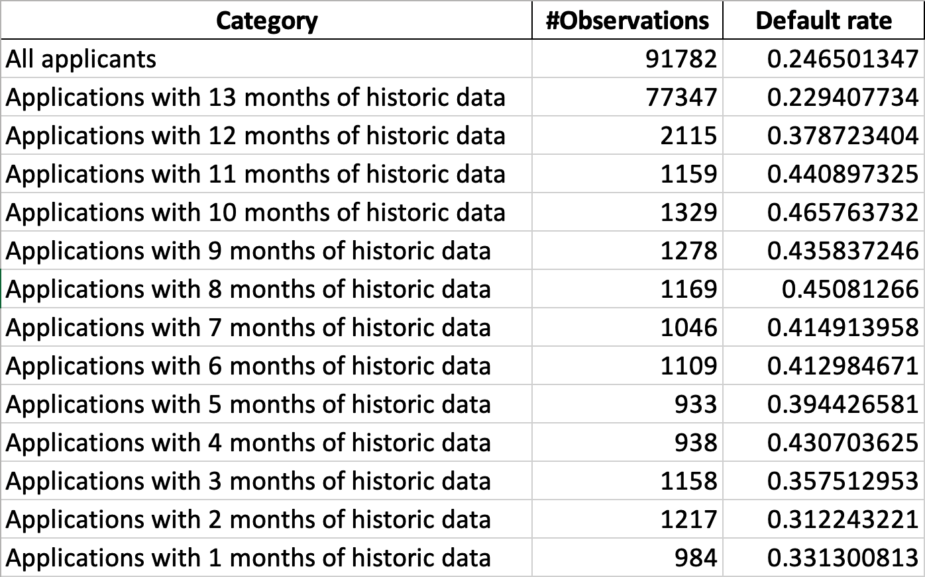
Data

Slide 4
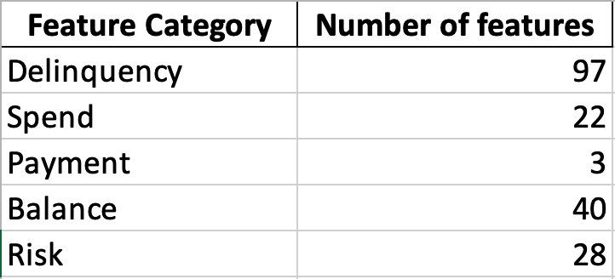
Features

Slide 5
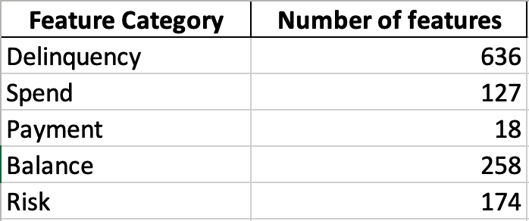
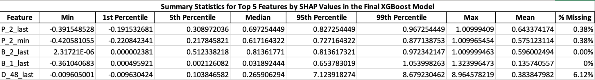
Feature Engineering
Numeric Features
Mean of the column
Standard Deviation of the data
Min of that feature
Max of the variable
Last Value in the column
Aggregation Across Customers
Categorial Features
Response Rate in Last 6 Months
Ever Response in Last 12 Months
Creation of New Features
Handling of Missing Values

Slide 6
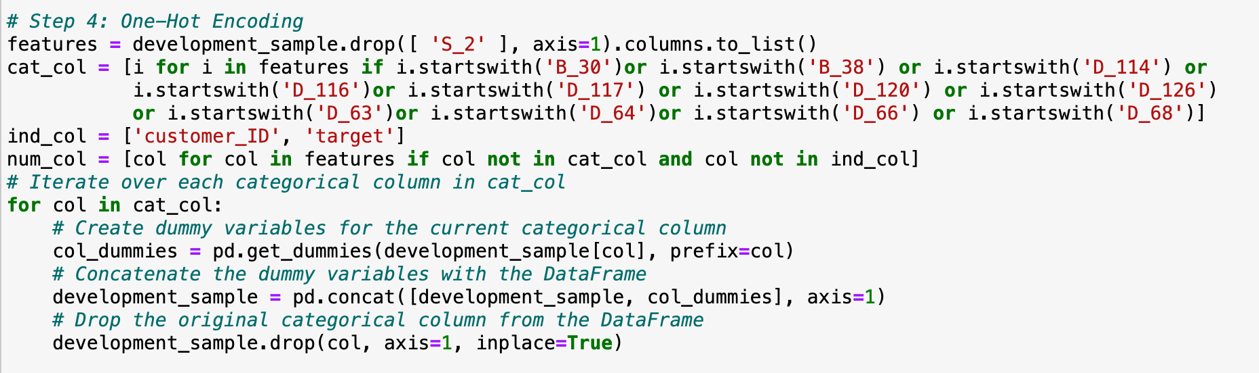
Data Processing – One Hot Encoding
11 Categorical features processed with One-Hot Encoding.
45 Indicator features created retaining the original categorical feature name suffixed with discrete values from each category.

Slide 7
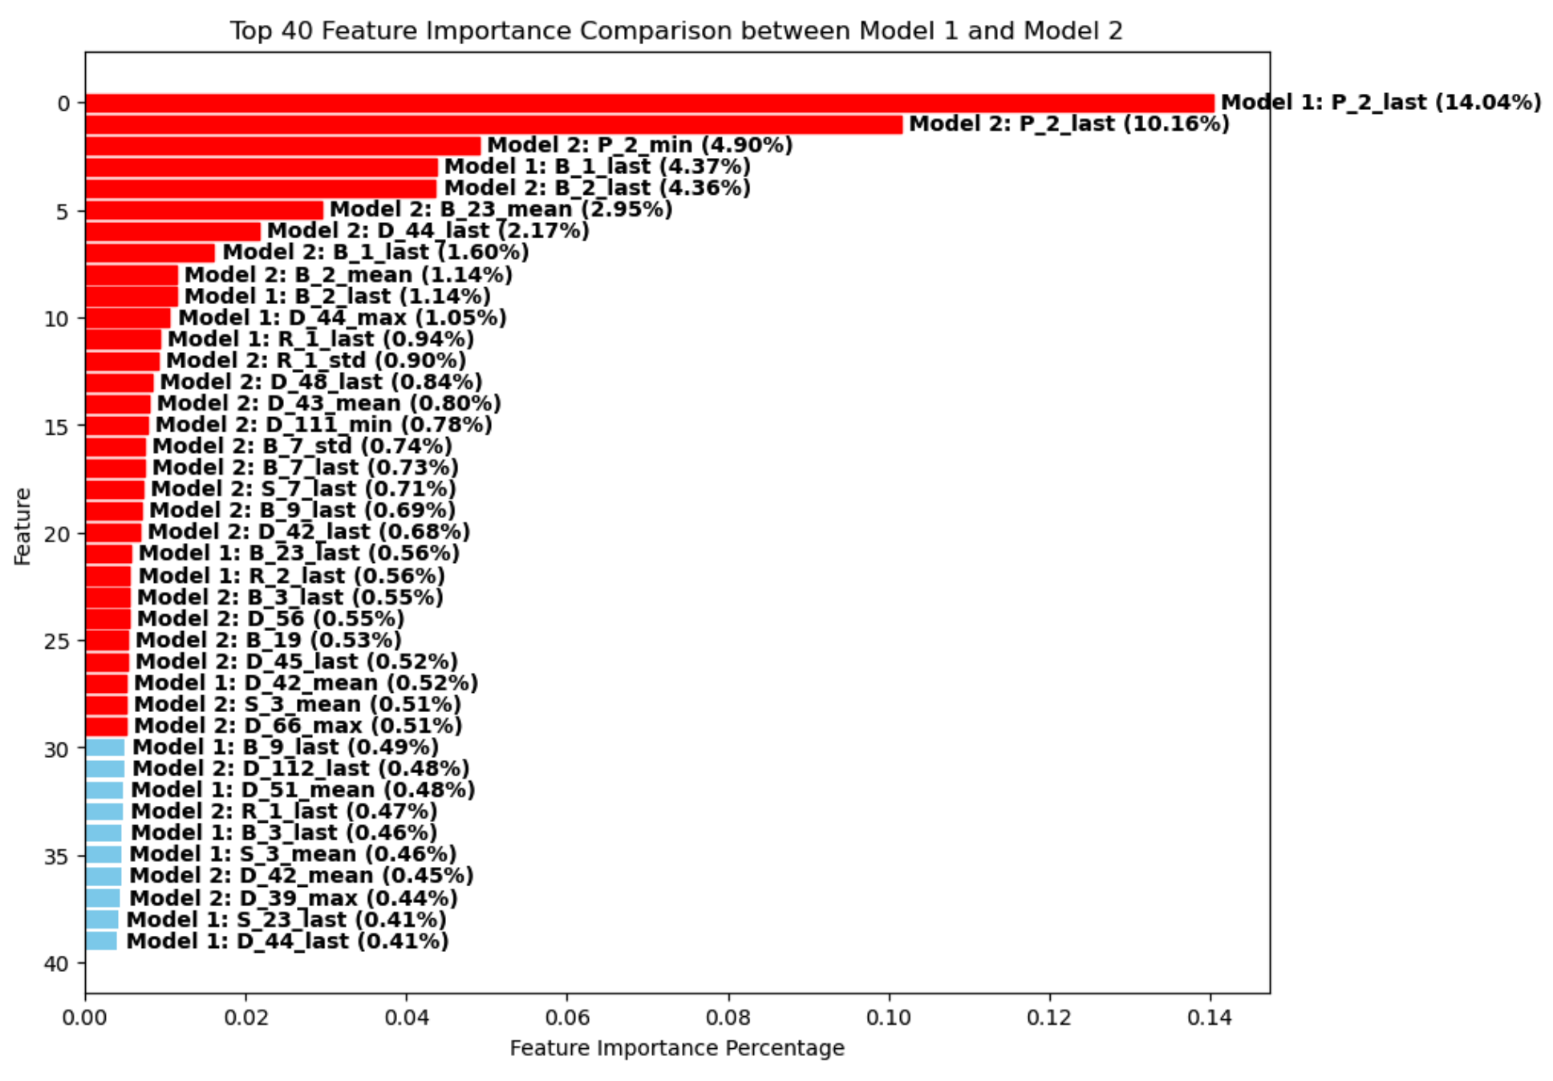

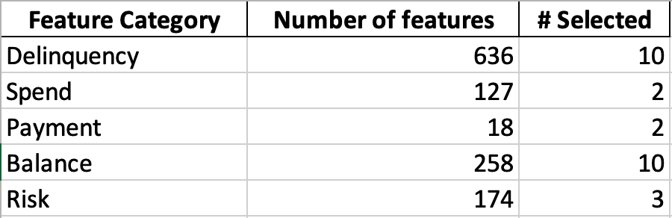
Feature Selection
Feature importance was calculated from two XGBoost models trained on the training dataset.
Selected features have a feature importance of higher than 0.5% in any of the two models.

Slide 8
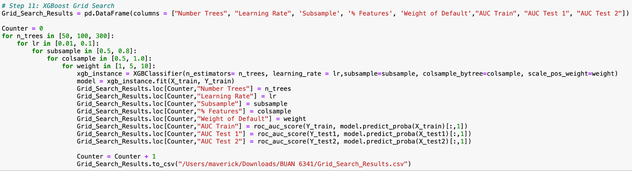
XGBoost - Grid Search

Slide 9
XGBoost - Grid Search
Grid Search Implementation: Implemented grid search to explore parameter combinations systematically.
Number of Models Trained: Trained multiple models by iterating over 36 different parameter combinations.
Lessons Learned: Discovered the impact of parameters on model performance and identified optimal settings.
Optimization Process: Iteratively adjusted parameters to enhance model performance on evaluation metrics.
Balancing Act: Balanced model complexity with performance, prioritizing parameter combinations yielding the best results.
Efficiency Improvements: Streamlined grid search to optimize computational resources while maximizing effectiveness.
Optimal Parameter Identification: Identified parameter configurations maximizing AUC on training and test datasets.
Generalization Insights: Explored how parameter settings affected model generalization to unseen data, ensuring robustness.

Slide 10
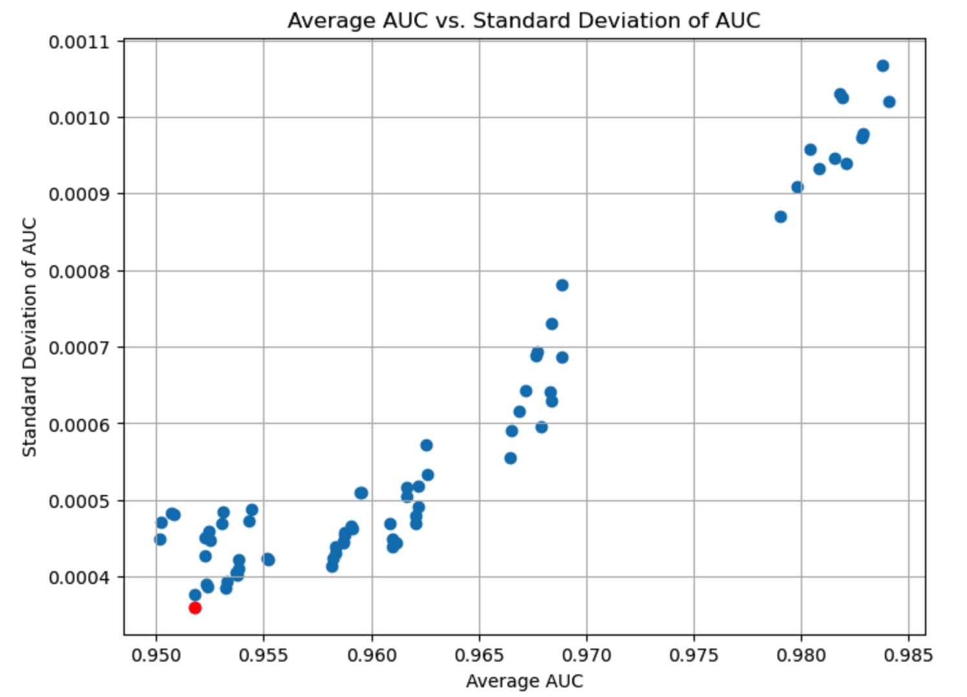
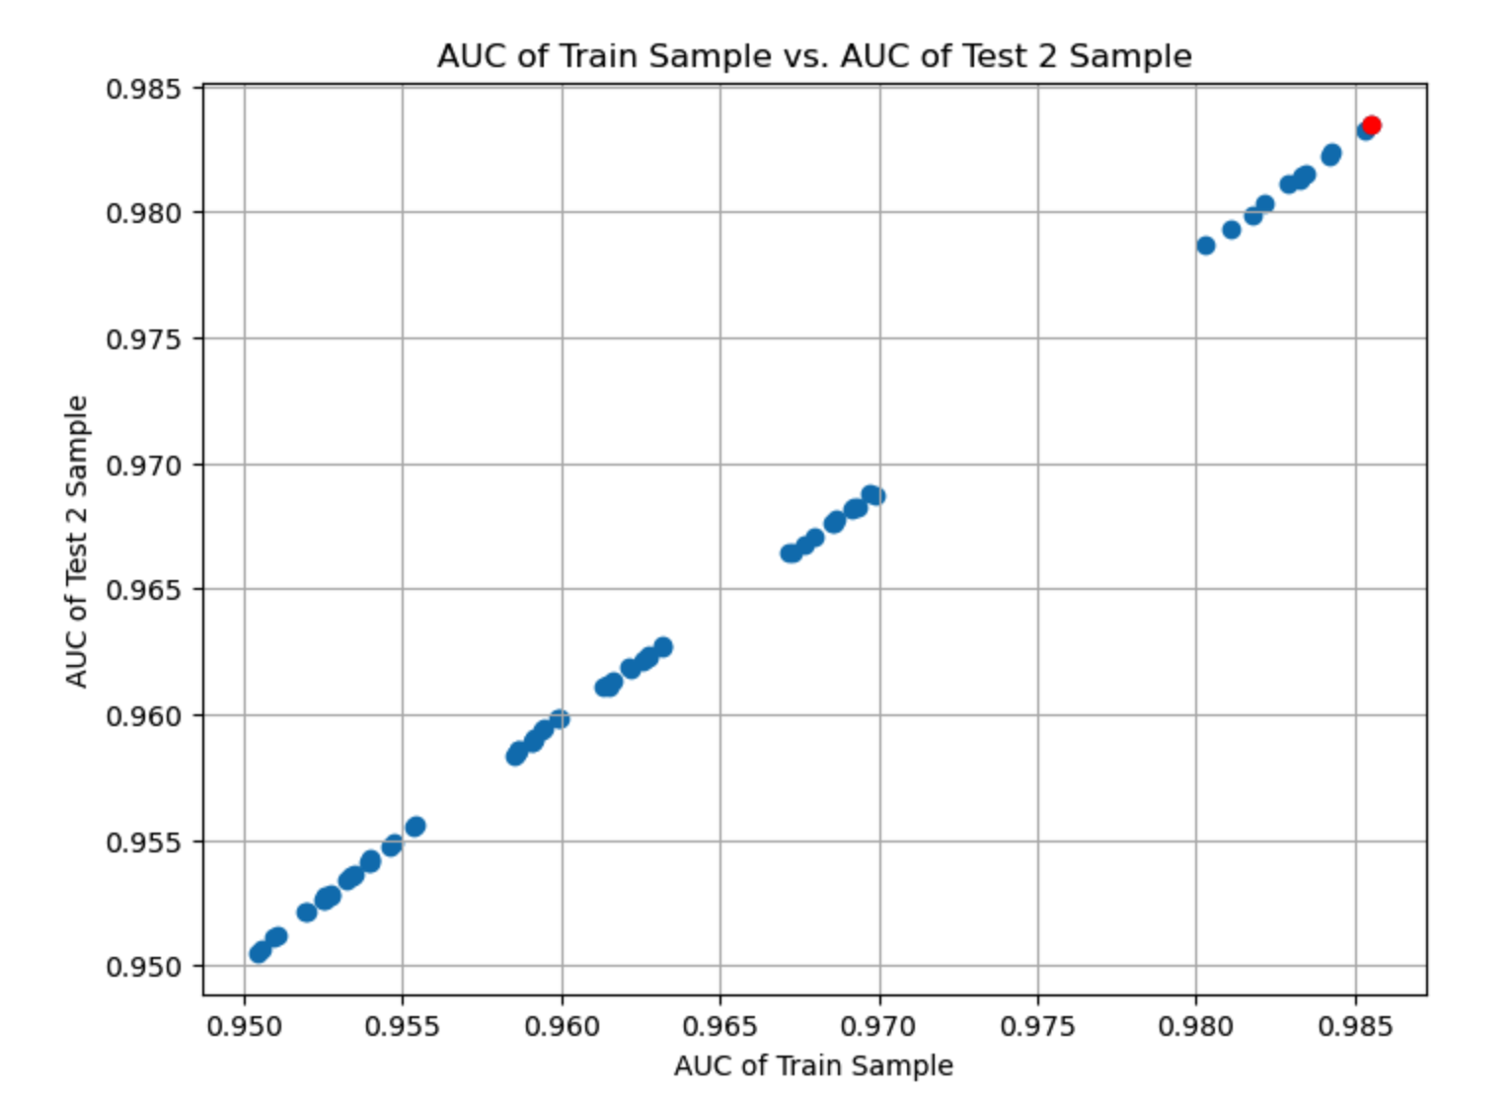
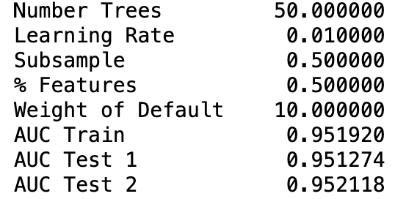
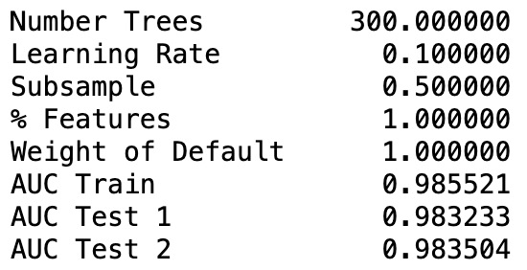
XGBoost - Grid Search

Slide 11
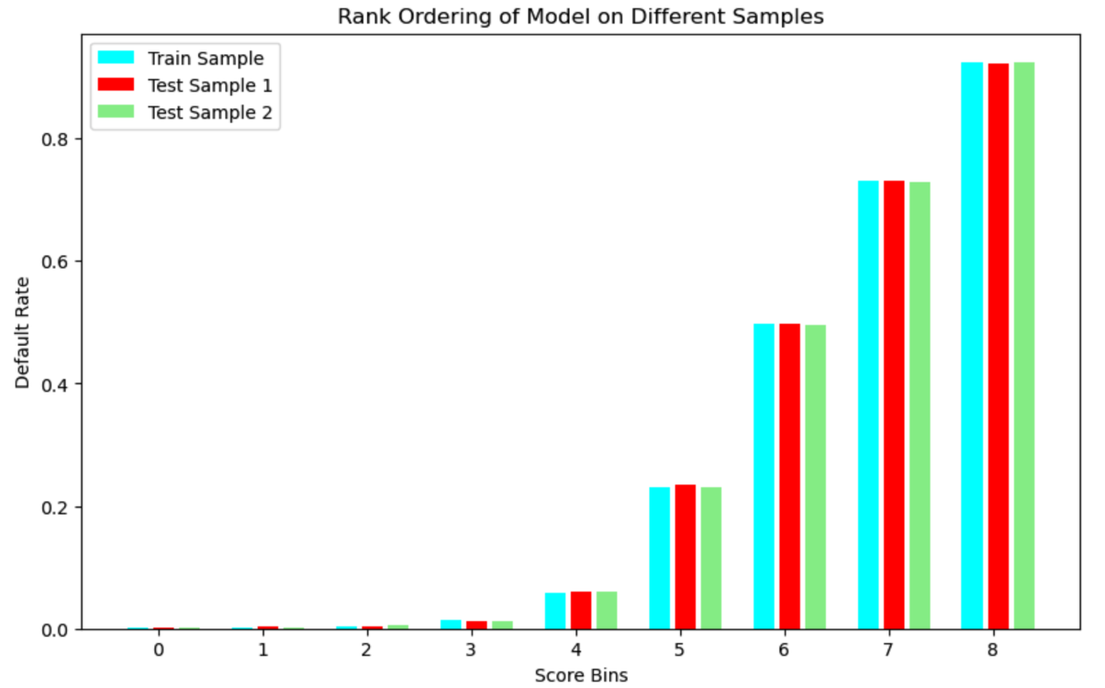
XGBoost – Final Model

Slide 12
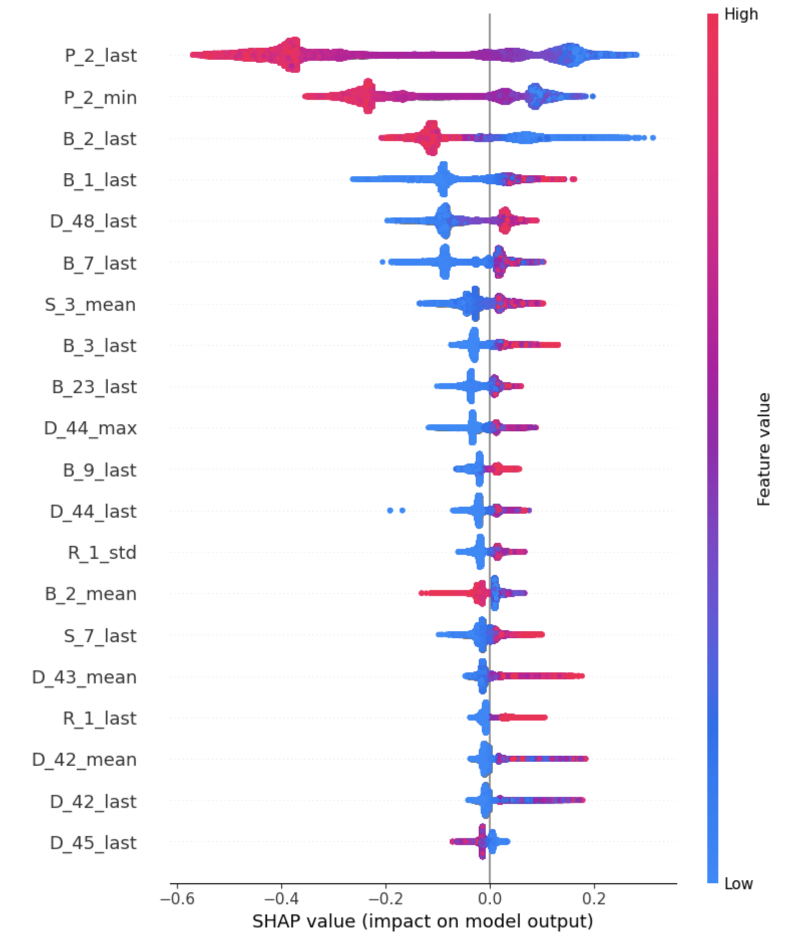
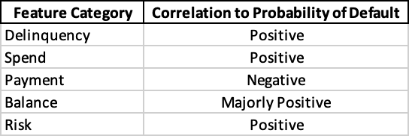
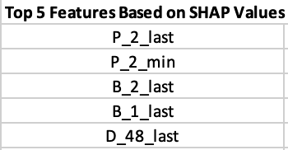
XGBoost – SHAP Analysis
SHAP Beeswarm Graph
Final XGBoost model applied to Test 2 sample

Slide 13
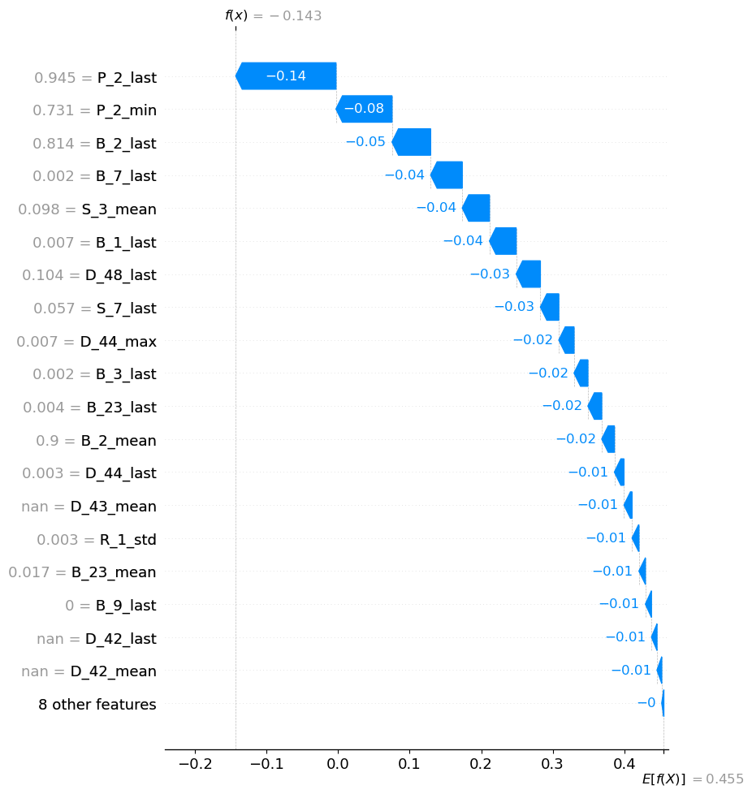
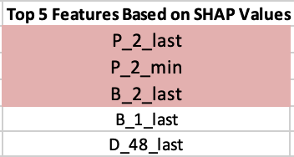
XGBoost – SHAP Analysis
SHAP Waterfall Graph
Top Feature Contribution to the PD is 25.78%
3 of the top 5 features make significant contributions to the PD:

Slide 14
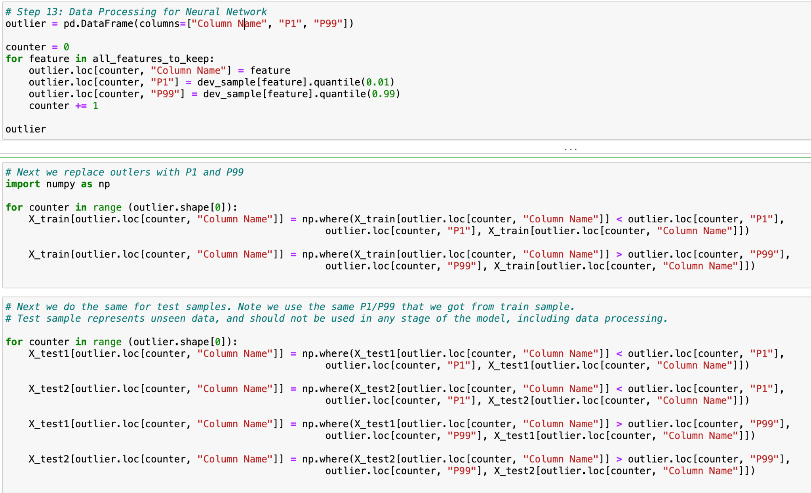
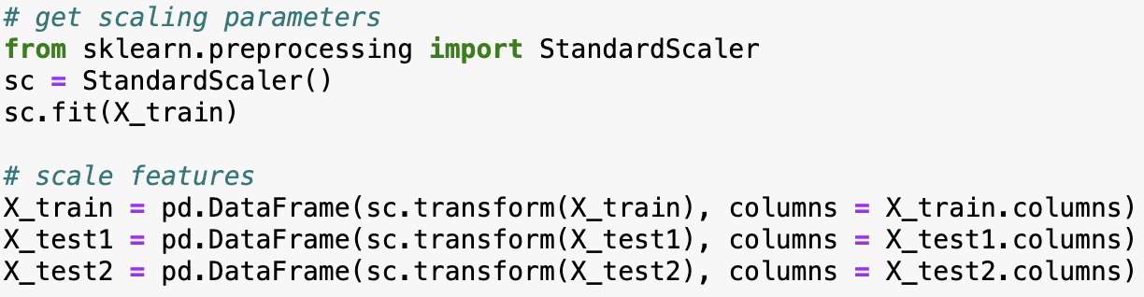
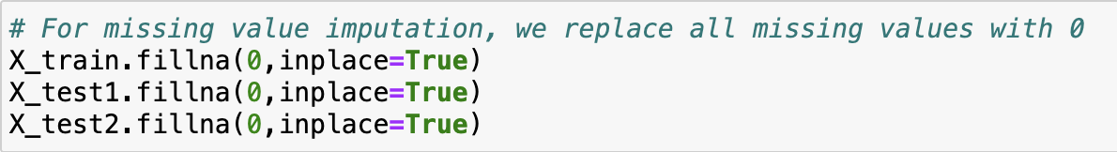
Neural Network – Data Processing
1% floor
99% cap
Outlier Treatment
StandardScalar()
Feature Scaling
Replace missing values with 0
Missing Value Imputation

Slide 15
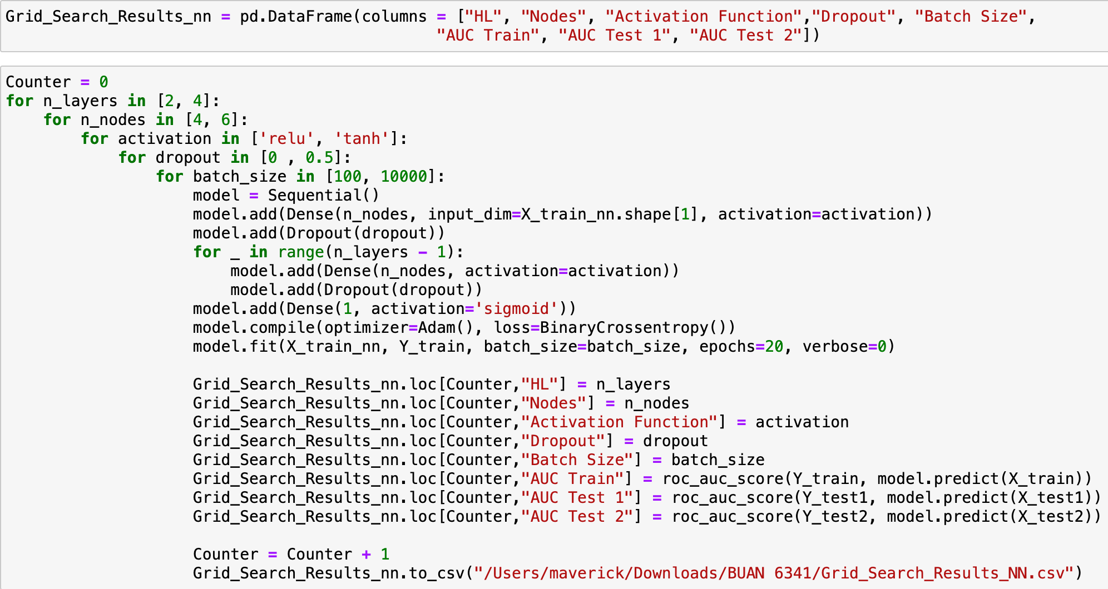
Neural Network - Grid Search

Slide 16
Neural Network - Grid Search
Number of Hidden Layers (n_layers): We consider 2 and 4 hidden layers. This choice allows us to explore both simpler and more complex architectures to see which one performs better on our data.
Number of Nodes per Layer (n_nodes): We explore two options: 4 and 6 nodes per layer. This parameter controls the model's capacity and complexity. By testing different numbers of nodes, we can find the optimal balance between model complexity and performance.
Activation Function (activation): We consider both ReLU and tanh activation functions. ReLU is widely used and often provides good performance, while tanh can capture more complex patterns in the data. Testing both allows us to see which one works better for our problem.
Dropout Rate (dropout): We experiment with dropout rates of 0 and 0.5. Dropout is a regularization technique used to prevent overfitting by randomly dropping a fraction of input units during training. Testing different dropout rates helps us find the optimal level of regularization.
Batch Size (batch_size): We try two batch sizes: 100 and 10,000. Batch size affects the speed and stability of the training process. Smaller batch sizes may lead to more noise in the optimization process but can result in faster convergence, while larger batch sizes can provide smoother gradients but may take longer to train.
This grid search explores a total of :-
2×2×2×2×2=32
2×2×2×2×2=32 different combinations of hyperparameters. For each combination, the code trains a neural network model, evaluates its performance on the training set and two test sets (Test 1 and Test 2), and records the results in a dataframe (Grid_Search_Results_nn). Finally, the results are saved to a CSV file for further analysis.
Through grid search, we can gain insights into how different combinations of hyperparameters affect model performance. It helps us understand which hyperparameters are crucial for achieving better results and provides valuable information for building more effective neural network models.

Slide 17
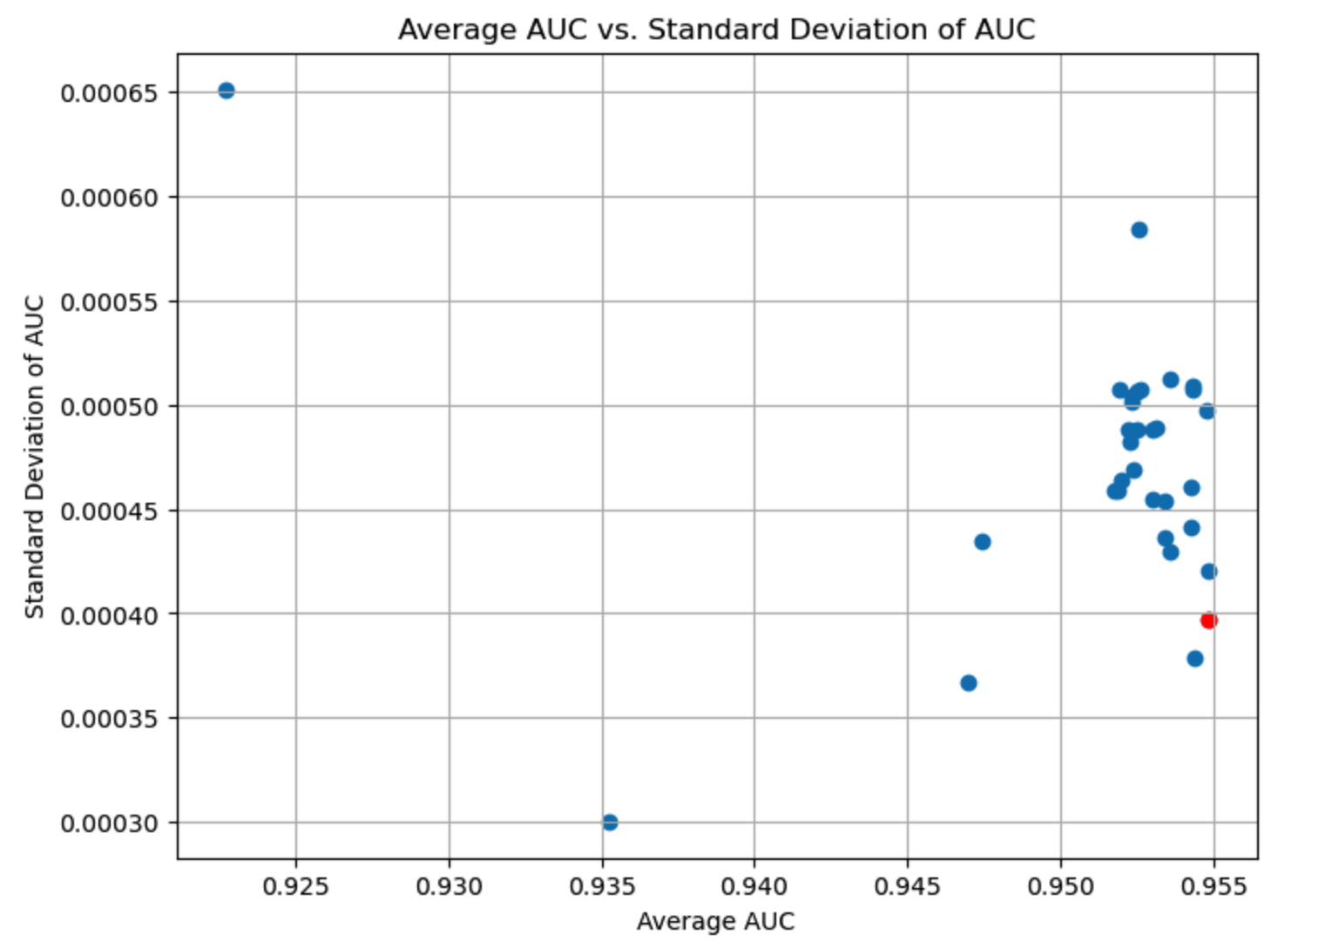
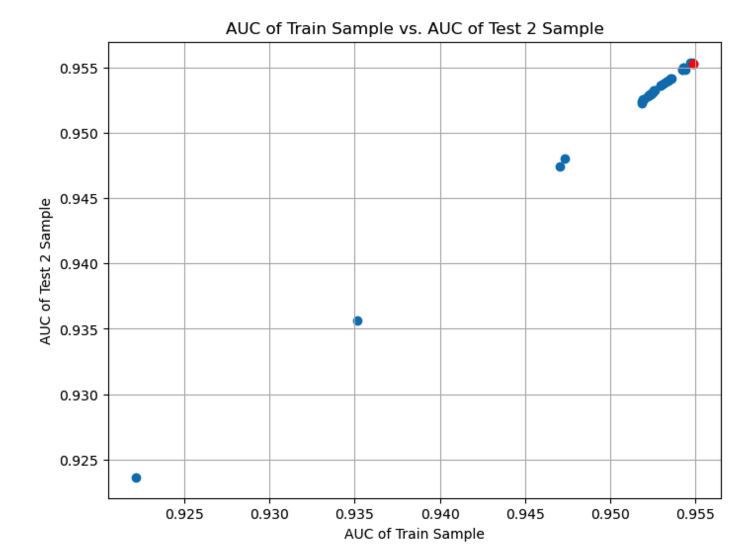
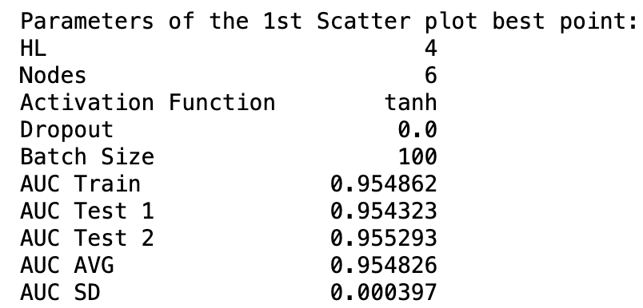
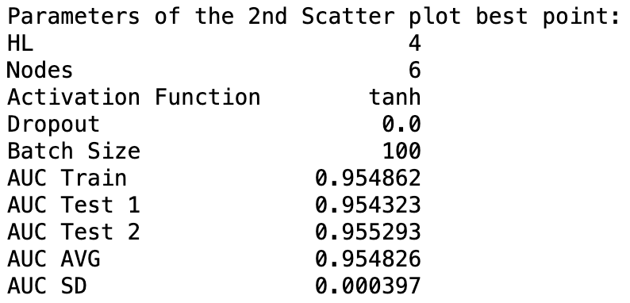
Neural Network - Grid Search

Slide 18
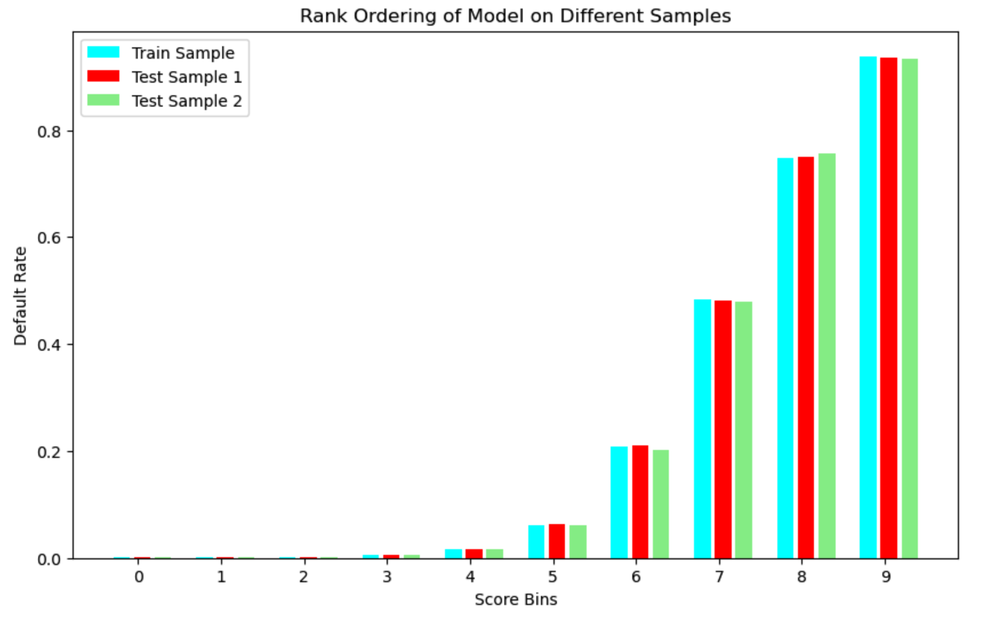
Neural Network – Final Model

Slide 19
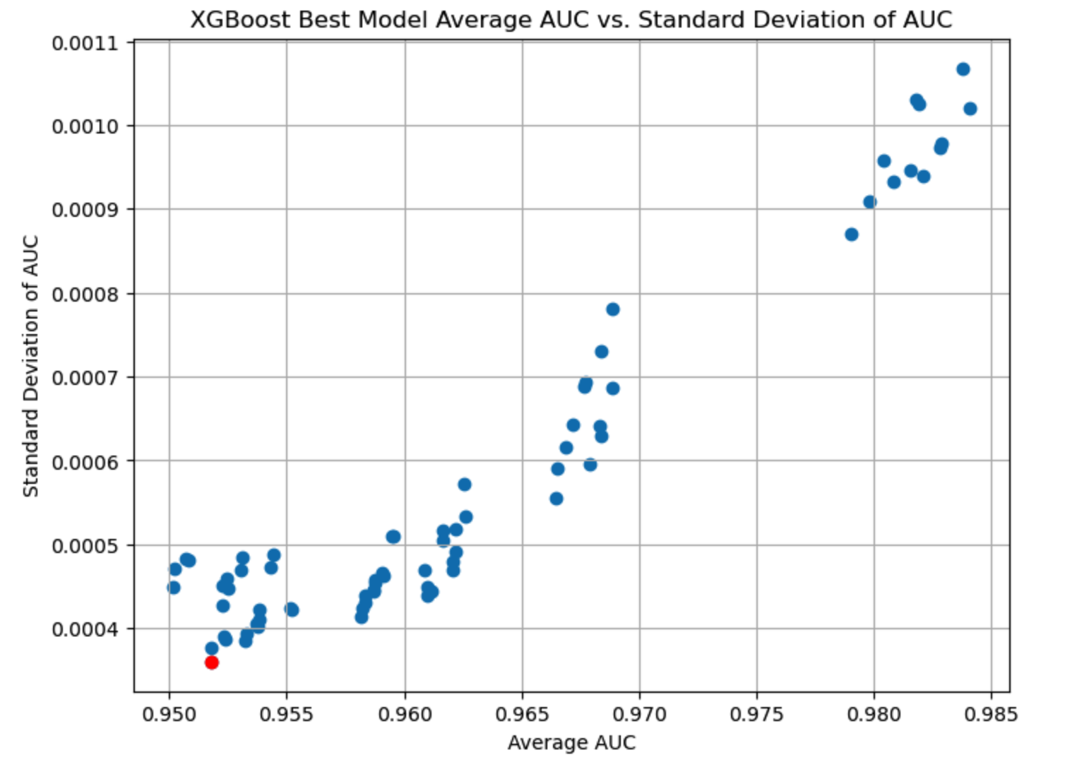
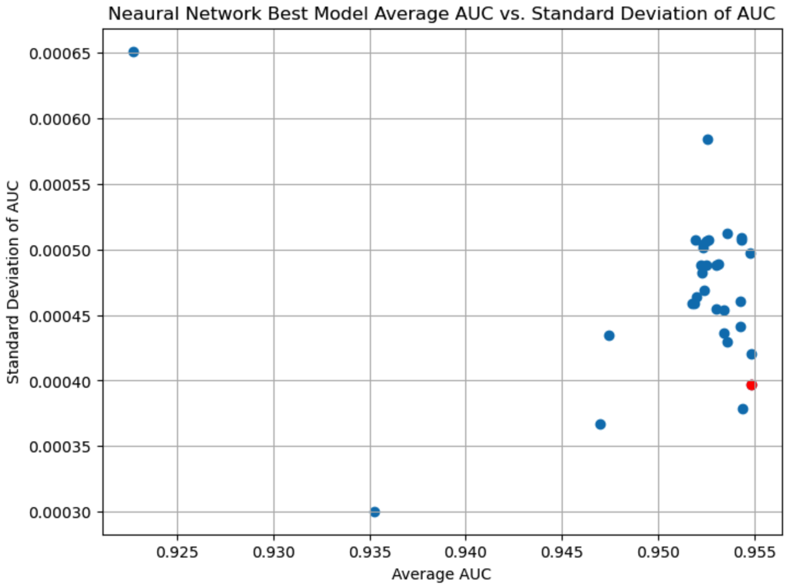
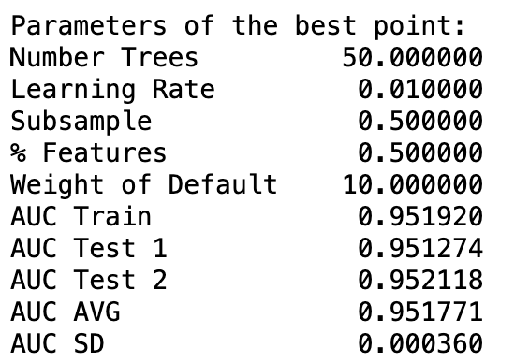
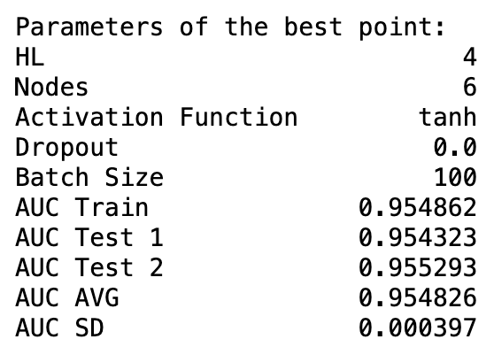
Final Model

Slide 20
Final Model
Reasons for Choosing the Neural Network:
Higher AUC Scores: Neural Network demonstrated slightly superior predictive performance compared to XGBoost, as indicated by higher AUC scores.
Flexibility in Model Architecture: The flexibility of Neural Networks in capturing complex patterns and relationships in the data, given the ability to adjust the number of layers and nodes is a plus feature.
Potential for Feature Learning: Neural Network has the capability to learn intricate features and patterns from the data, making it suitable for complex and nonlinear relationships.
Consistent Performance: Neural Network has consistent performance across different datasets, indicating robustness and reliability in predictions.

Slide 21
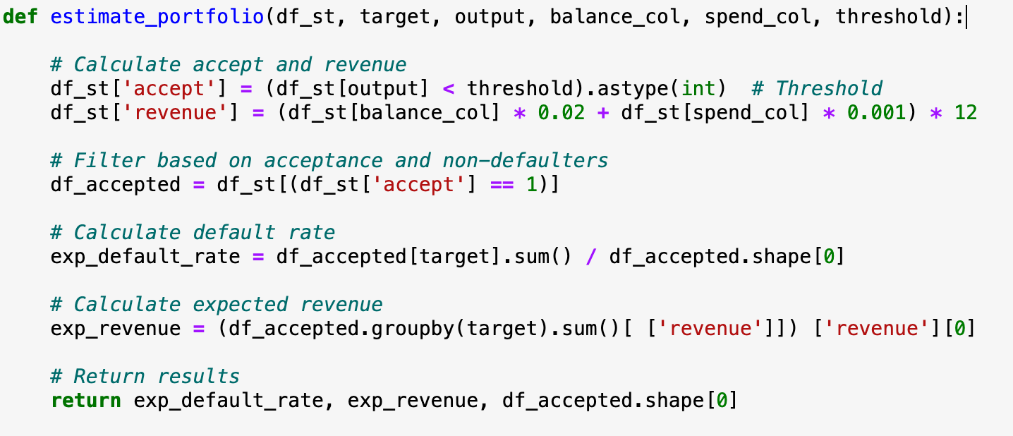
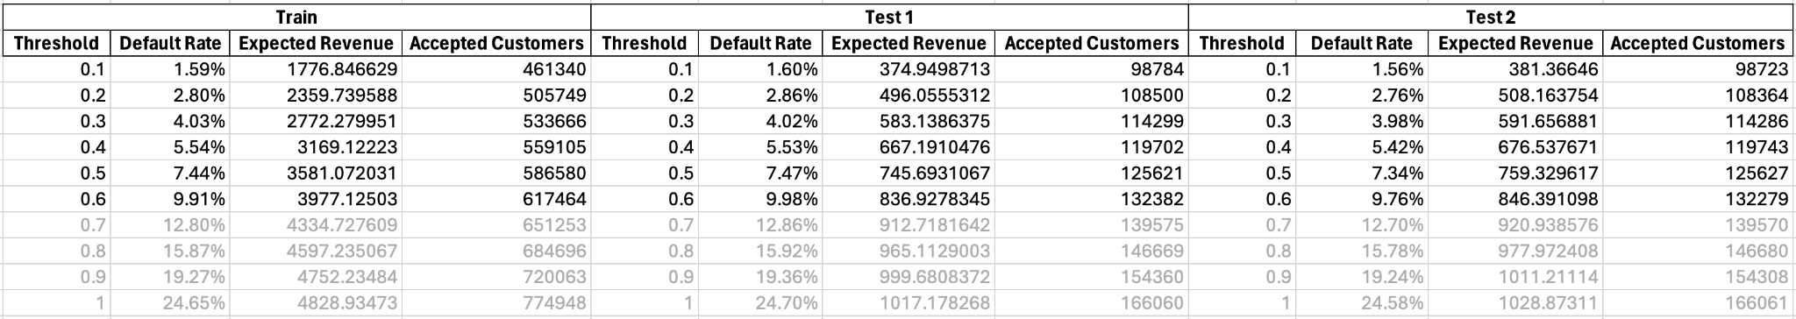
Strategy

